Slide 1
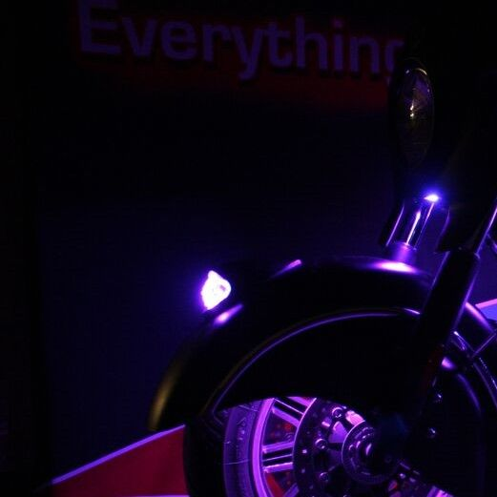
MAGICAL WIZARD INDIAN WAR BONNET LED KIT
Sku: 2040-2170

Slide 2
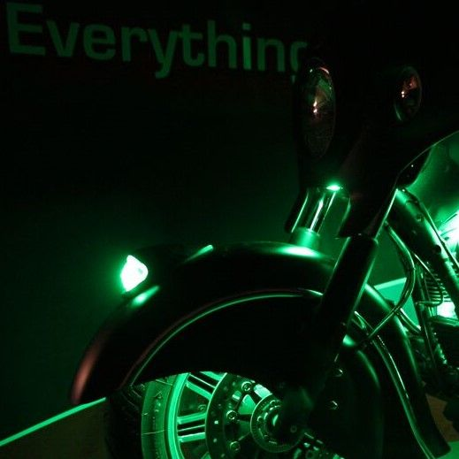
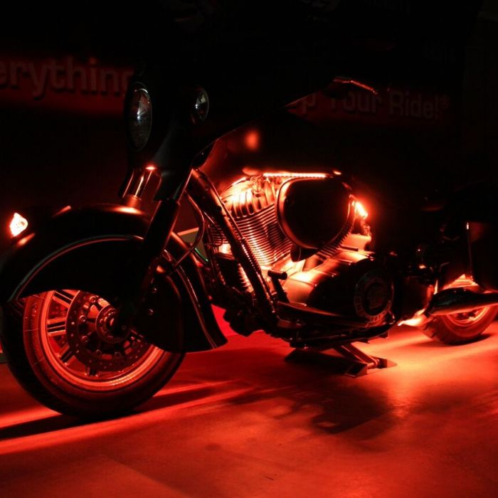
ADD COLOR CHANGING LED ILLUMINATION TO THE WAR BONNET
RIDE IN STYLE AND COLOR
MAKE SURE YOU AND YOUR BIKE ARE SEEN

Slide 3
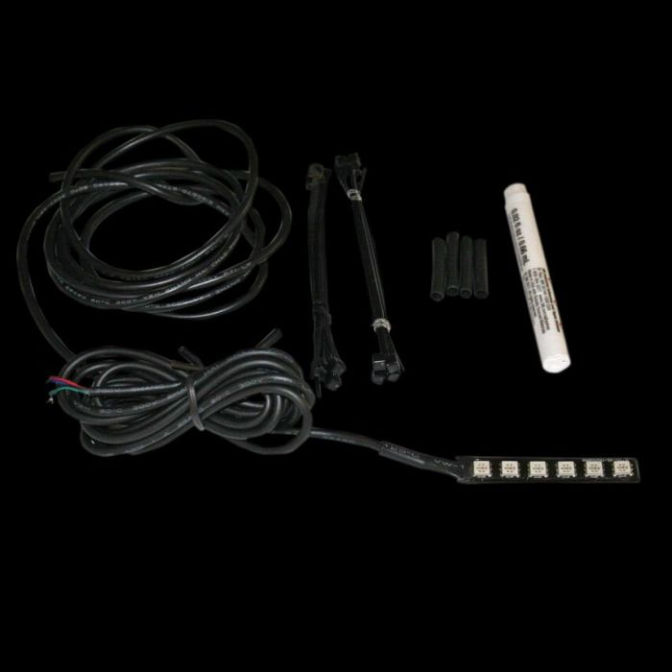
FITMENT
All Indian Models Compatible with 12VDC systems with a negative ground.
Requires the use of Standard CCM-5 or Bluetooth CCM-6 (sold separately).
Recommended to use with Magical Wizard Engine Kit for Indian.

Slide 4
Bonnet LED Kit includes the following products:
1 Standard Pod (2-5/16" L x 9/16" W x 7/16" D) for mounting inside war bonnet
1 Complete Installation Kit which includes adhesive primer, heat shrink, extra cable and tie wraps. wraps.

Slide 5
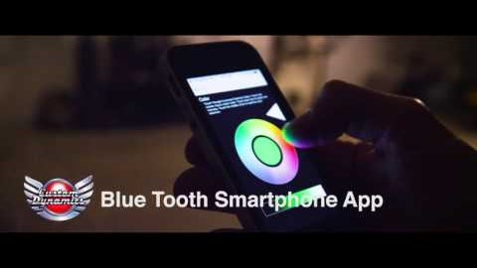
Everything to Light Up Your Ride

